Slide 1





UNIVERSITI TEKNOLOGI MALAYSIA
DSPD 1733 : DATA STRUCTURES AND ALGORITHMS
P u s a t P e n g a j i a n D i p l o m a , S PA C E U T M K u a l a L u m p u r
Jabatan Sains Komputer dan Perkhidmtan

Slide 2


CHAPTER 1:
INTRODUCTION
Introduction to data
Abstract data types (ADT), atomic and composite data Model for an ADT, ADT operations and implementations Examples of an ADT such as array, pointer and structures Example using data structure in applications.
www.utm.my

Slide 3


01
Basic Concept of Data Structure
Primitive Data Structures, Non-Primitive Data Structure, Linear and Non Linear Data Structure
02
Data
Atomic and Composite data, Abstract Data Types (ADT)
03
Criteria Choosing the Right Data Structure
Time and Space Complexity
04
Example using Data Structure in applications.
Importance of the Data Structure
www.utm.my

Slide 4

Basic Concepts of Data Structure
A data structure is a specialized format for organizing and storing data in a computer so that it can be accessed and modified efficiently.
In computer science, data structures are essential tools for managing large amounts of data, enabling programs to run efficiently and effectively.
The purpose of data structures is to store, retrieve, and modify data in a way that allows for optimal performance in tasks such as searching, sorting, inserting, and deleting data.
Data structures can be classified into two broad categories:
Primitive Data Structures
Non-Primitive Data Structures
Data structures are foundational to algorithms and help in problem-solving by providing structured ways of organizing data. The right data structure can greatly affect the performance of a program, and choosing the wrong one can lead to inefficiencies.
www.utm.my

Slide 5

Primitive Data Structures
Basic types of data structures that serve as the building blocks for other complex data structures. They typically represent a single data element. Consider as a single, no decomposable entity where if you decompose it will not have the same characteristics of the original type
Also known as Atomic data or Scala data or Elementary data
Common primitive data types include:
Integer: A whole number, positive or negative, without a decimal point.
Float: A number that includes a decimal point.
Character: A single letter, number, or symbol.
Boolean: Represents true or false values.
These primitive data types can be used to define more complex data structures.
www.utm.my

Slide 6

Non-Primitive Data Structures
These are more complex structures that can store multiple values or objects and are built using primitive data types. They allow for the storage, organization, and manipulation of larger sets of data.
Non-primitive data structures can be divided into two main types:
Linear Data Structure
Non-Linear Data Structure
www.utm.my

Slide 7

Linear Data Structures
In a linear data structure, elements are arranged in a sequential manner, where each element is connected to its previous and
next element.
Common examples include:
•Arrays: A collection of elements of the same type, stored in contiguous memory locations.
Example: [1, 2, 3, 4]
•Linked Lists: A collection of elements (called nodes), where each node contains data and a reference (link) to the next node in the sequence.
Example: head -> 1 -> 2 -> 3 -> 4 -> null
•Stack: A collection where elements follow the Last In, First Out (LIFO) principle, meaning the last element added is the first one to be removed.
Example: A stack of plates, where the last plate placed on top is the first one to be taken off.
•Queues: A collection where elements follow the First In, First Out (FIFO) principle, meaning the first element added is the first one to be removed.
Example: People standing in line, where the first person to enter the line is the first one to be served.
www.utm.my

Slide 8
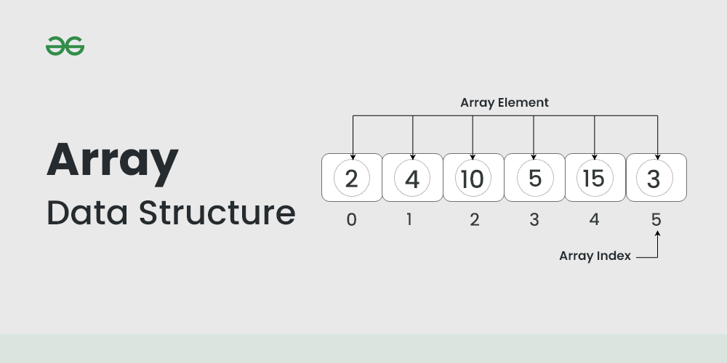
Array
•Arrays: A collection of elements of the same type, stored in contiguous memory locations.
Example: [2,4,10,5,15,3]
[PASSWORD]

Slide 9

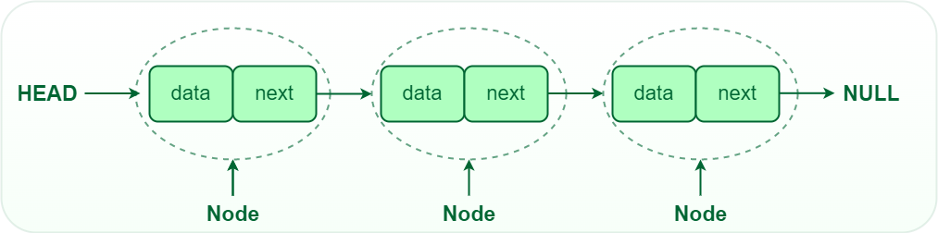

Linked list
Playlist: each song points to the next one

Slide 10
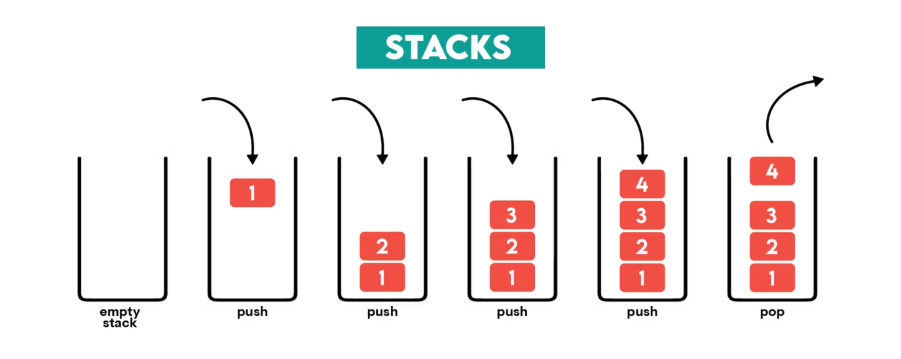
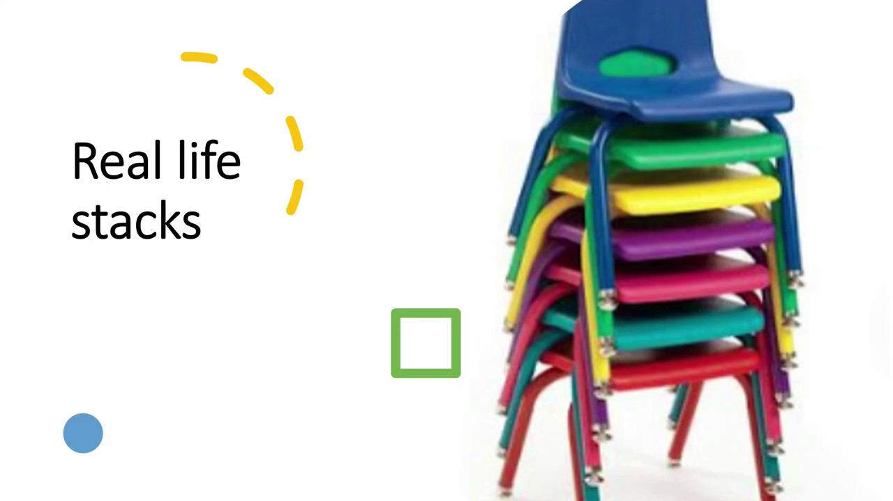
Stack
•Stack: A collection where elements follow the Last In, First Out (LIFO) principle, meaning the last element added is the first one to be removed.
Example: A stack of plates, where the last plate placed on top is the first one to be taken off.

Slide 11
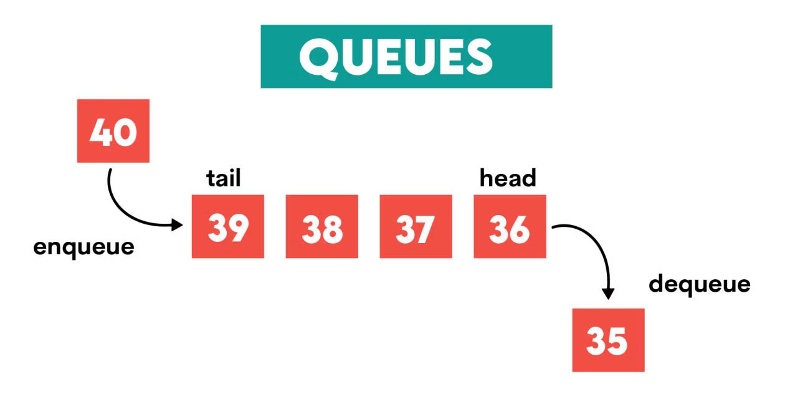

Queues
•Queues: A collection where elements follow the First In, First Out (FIFO) principle, meaning the first element added is the first one to be removed.
Example: People standing in line, where the first person to enter the line is the first one to be served.

Slide 12
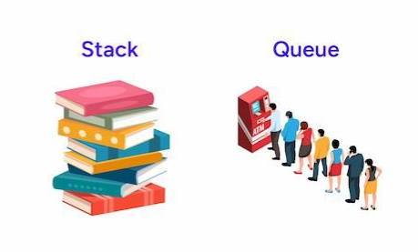
Last In, First Out (LIFO)
First In, First Out (FIFO)

Slide 13

Non-Linear Data Structures
In non-linear data structures, elements are not arranged in a sequential manner. These structures are more complex and allow for multiple relationships between elements.
Examples include:
Trees: A hierarchical structure consisting of nodes connected by edges, with one node as the root and other nodes as branches or leaves. The most common type is a binary tree, where each node has at most two children.
Example: A family tree or a folder structure.
Graphs: A collection of nodes (vertices) and edges, where edges connect nodes. Graphs can be directed or undirected, and they can be cyclic or acyclic.
Example: A social network where users are nodes, and connections between users are edges.
www.utm.my

Slide 14
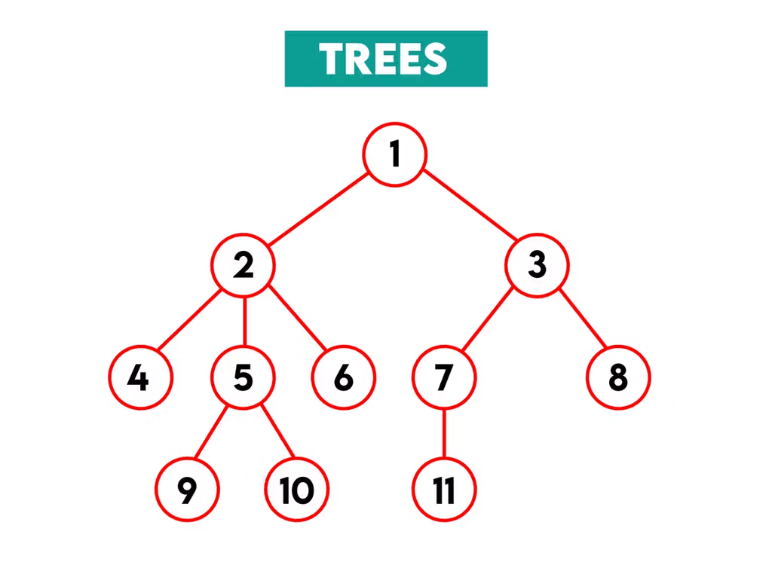
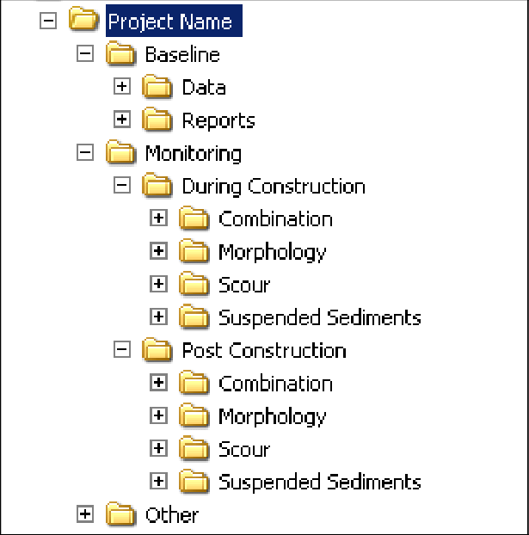
Trees:
Trees: A hierarchical structure consisting of nodes connected by edges, with one node as the root and other nodes as branches or leaves. The most common type is a binary tree, where each node has at most two children.
Example: A family tree or a folder structure.

Slide 15
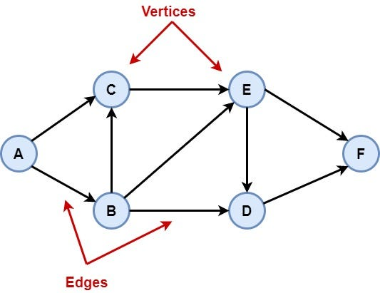
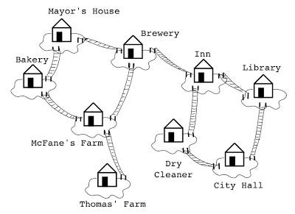
Graphs
Graphs: A collection of nodes (vertices) and edges, where edges connect nodes. Graphs can be directed or undirected, and they can be cyclic or acyclic.
Example: A social network where users are nodes, and connections between users are edges.

Slide 16
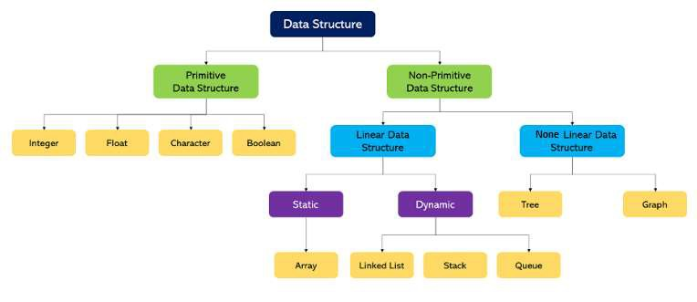
Data Structures Classification

Slide 17

Operations on Data Structures
Different data structures support different operations, but common operations include:
Insertion: Adding a new element to the structure. Deletion: Removing an element from the structure.
Traversal: Visiting each element in the structure, often done in a specific order. Search: Finding a specific element in the structure.
Update: Modifying the value of an element.
The choice of operations and their implementation determines the performance of algorithms.
www.utm.my

Slide 18

Abstract Data Types (ADT)
An Abstract Data Type (ADT) defines a data structure based on the operations that can be performed on it, independent of its internal implementation.
Examples of ADTs include:
List: A collection of elements, with operations like insert, delete, and search.
Set: A collection of unique elements, supporting operations like union, intersection, and difference.
Map/Dictionary: A collection of key-value pairs, allowing fast lookup by key.
The distinction between a data structure and an ADT is that a data structure refers to the concrete implementation, while an ADT focuses on the behavior and operations on the data.
www.utm.my

Slide 19
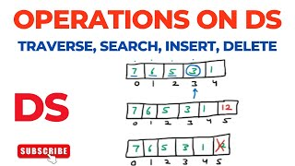
[DATA STRUCTURE]
www.utm.my

Slide 20
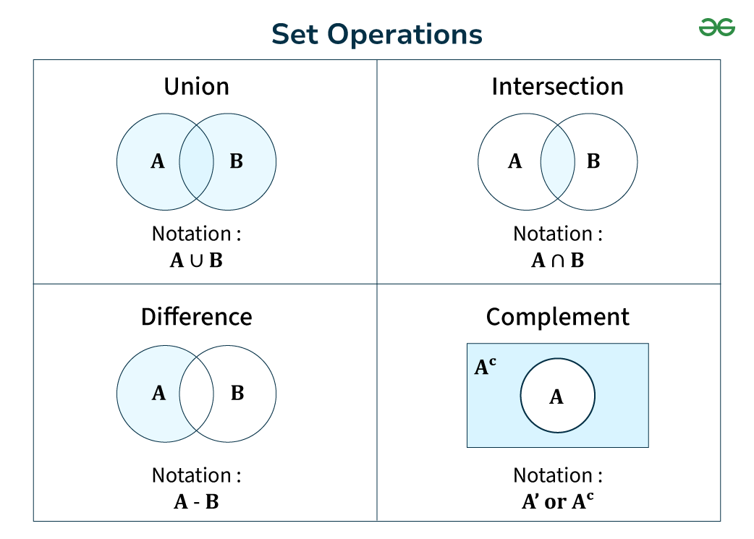
www.utm.my

Slide 21
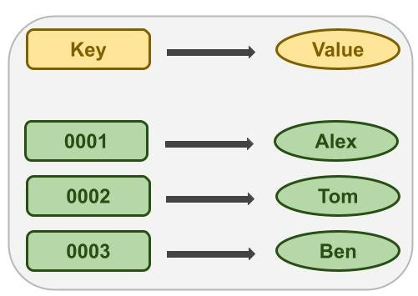
Key-Value pairs

Slide 22

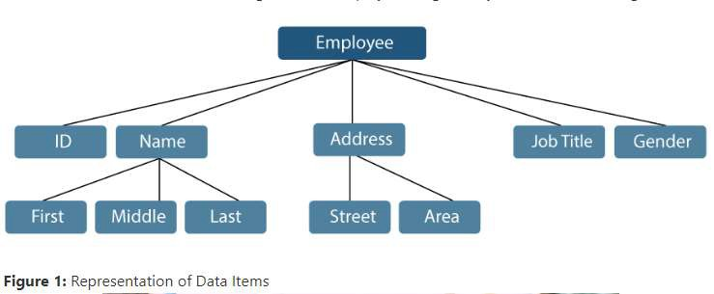
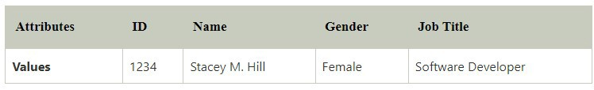
Abstract Data Types (ADT) (continue)
Fields: A single elementary unit of information symbolizing the Attribute of an Entity is known as a Field.
Record: A collection of different data items is known as a Record. For example: if referring to the employee entity then its name, id, address and job title can be grouped to form the record for the employee.
File: A collection of different Records of one entity type is known as a File. For example: if there are 100 employees, there will be 100 records in the related file containing data about each of the employees.
www.utm.my

Slide 23

Abstract Data Types (ADT) (continue)
Users are not concerned with how the task is done but rather with what it can do.
Example: need to store a collection of names in a manner that allow you to search rapidly for a given name.
So you will have data of names
Operation that you have to do with the data is to store and to search How the data will be store and search lets data structure do its part.
www.utm.my

Slide 24

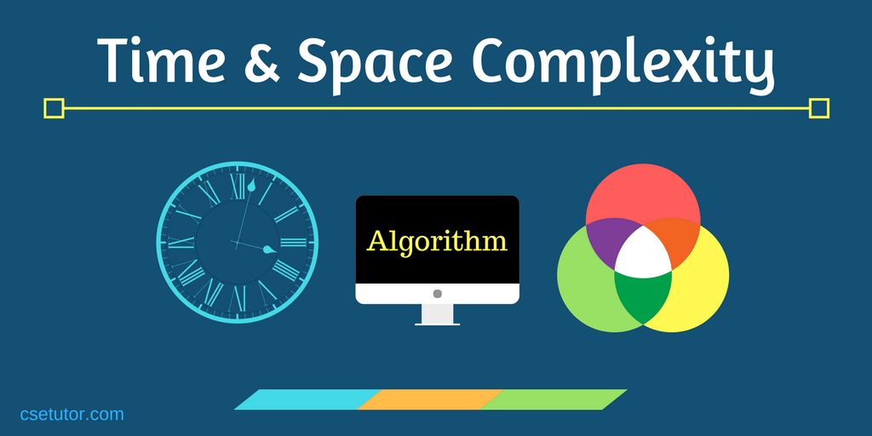

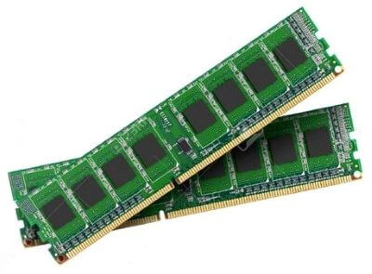
Time and Space Complexity
When evaluating a data structure, it's important to consider:
Time Complexity: How long an operation (like search, insert, delete) takes, often expressed in Big-O notation.
Space Complexity: How much memory the data structure consumes.
Efficient data structures are designed to optimize both time and space, ensuring faster execution and minimal memory usage.
www.utm.my

Slide 25

Criteria Choosing the Right Data Structure
The choice of data structure depends on:
The type of operations needed (searching, sorting, adding/removing elements).
The size of the dataset.
Time and space requirements for optimal performance.
For example, if you need to frequently insert or remove elements, a linked list may be more suitable than an array, as arrays require shifting elements, which can be slow.
www.utm.my

Slide 26



Importance of Data Structure
Data Organization and Management
Purpose: Data structures organize and store data in a systematic way to facilitate easy access and modification.
Example: Arrays store elements in a sequential manner, whereas trees organize hierarchical data efficiently.
Efficiency in Data Access
Purpose: They allow optimized data retrieval, which is crucial for performance-critical applications.
Example:
Hash tables provide constant time complexity (O(1)) for lookups.
Binary Search Trees offer logarithmic time complexity (O(log n)) for searching and insertion.
www.utm.my

Slide 27


Importance of Data Structure
Algorithm Optimization
Algorithms rely on appropriate data structures to enhance speed and reduce resource usage.
Example: Graphs are used in shortest-path algorithms like Dijkstra’s Algorithm to navigate networks.
Memory and Storage Management
Data structures optimize memory usage, reducing overhead and redundancy.
Example: Linked lists dynamically allocate memory, avoiding the wastage caused by fixed- size arrays.
www.utm.my

Slide 28
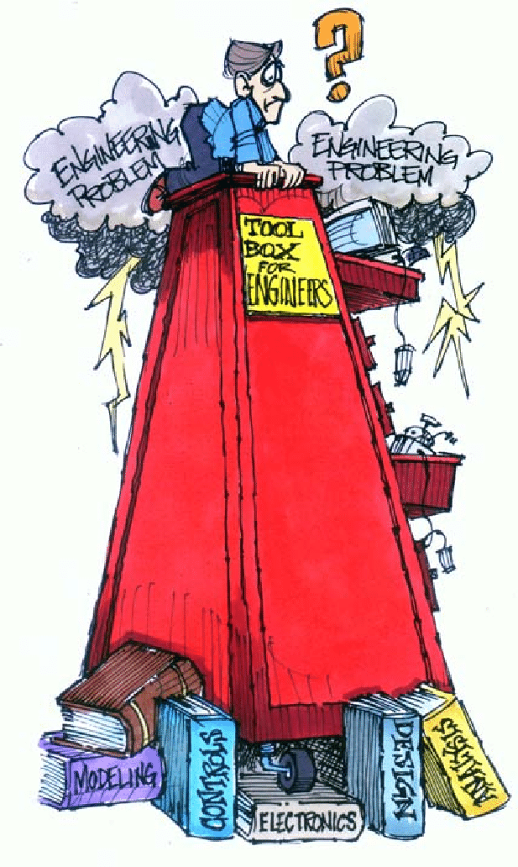


Importance of Data Structure (continue)
Problem Solving and Real-World Applications
Purpose: They model real-world scenarios and solve complex problems effectively.
Examples:
Stacks: Used in function calls, expression evaluation, and undo operations.
Queues: Manage tasks in printers, operating systems, and network buffers.
Graphs: Represent social networks, transportation systems, and recommendation engines.
Scalability in Software Development
Proper use of data structures ensures systems scale to handle large datasets and growing user bases.
Example: Databases use B-trees for indexing to support millions of queries efficiently.
www.utm.my

Slide 29




Importance of Data Structure (continue)
Basis for Advanced Technologies
Serve as a foundation for modern technologies like Machine Learning, Artificial Intelligence, and Big Data.
Example:
Heaps: Used in priority queues and scheduling tasks.
Tries: Support text processing, autocomplete, and IP routing.
Competitive Programming and Interviews
Data structure knowledge is vital for coding competitions and job interviews, where problems often test logic and optimization.
www.utm.my

Slide 30

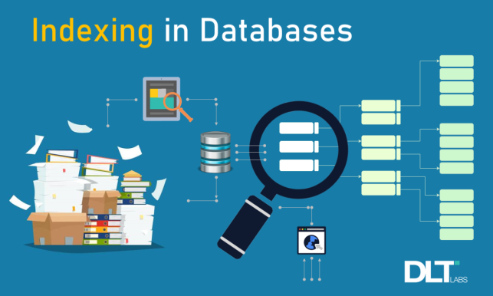
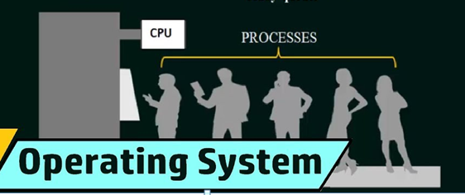
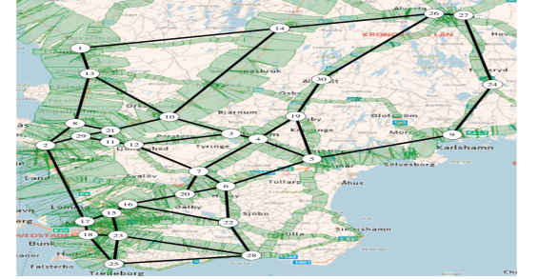
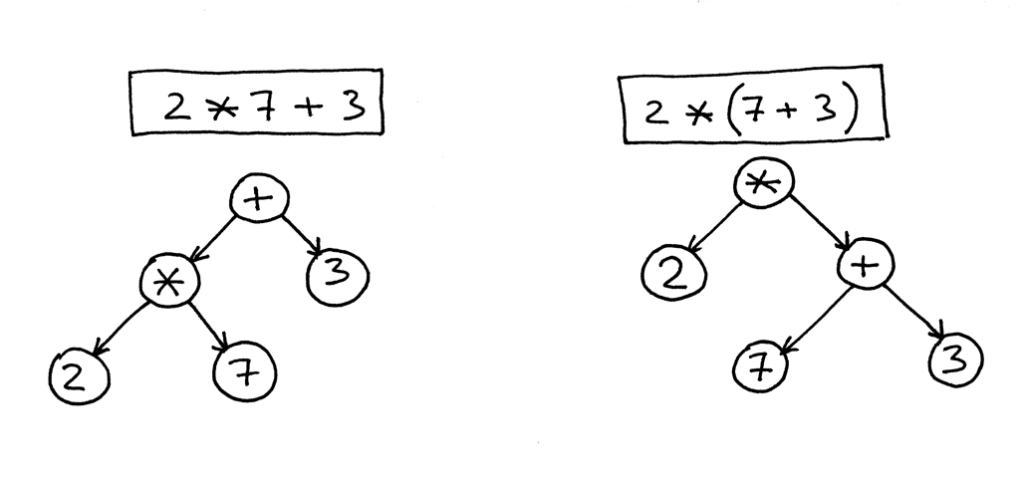
Applications of Data Structures
Databases: Use trees, hash tables, and B-trees for indexing and searching.
Operating Systems: Use queues for job scheduling and stacks for function calls.
Networking: Graphs represent connections and routes in networks.
Compilers: Use trees for parsing expressions and generating code.
www.utm.my

Slide 31


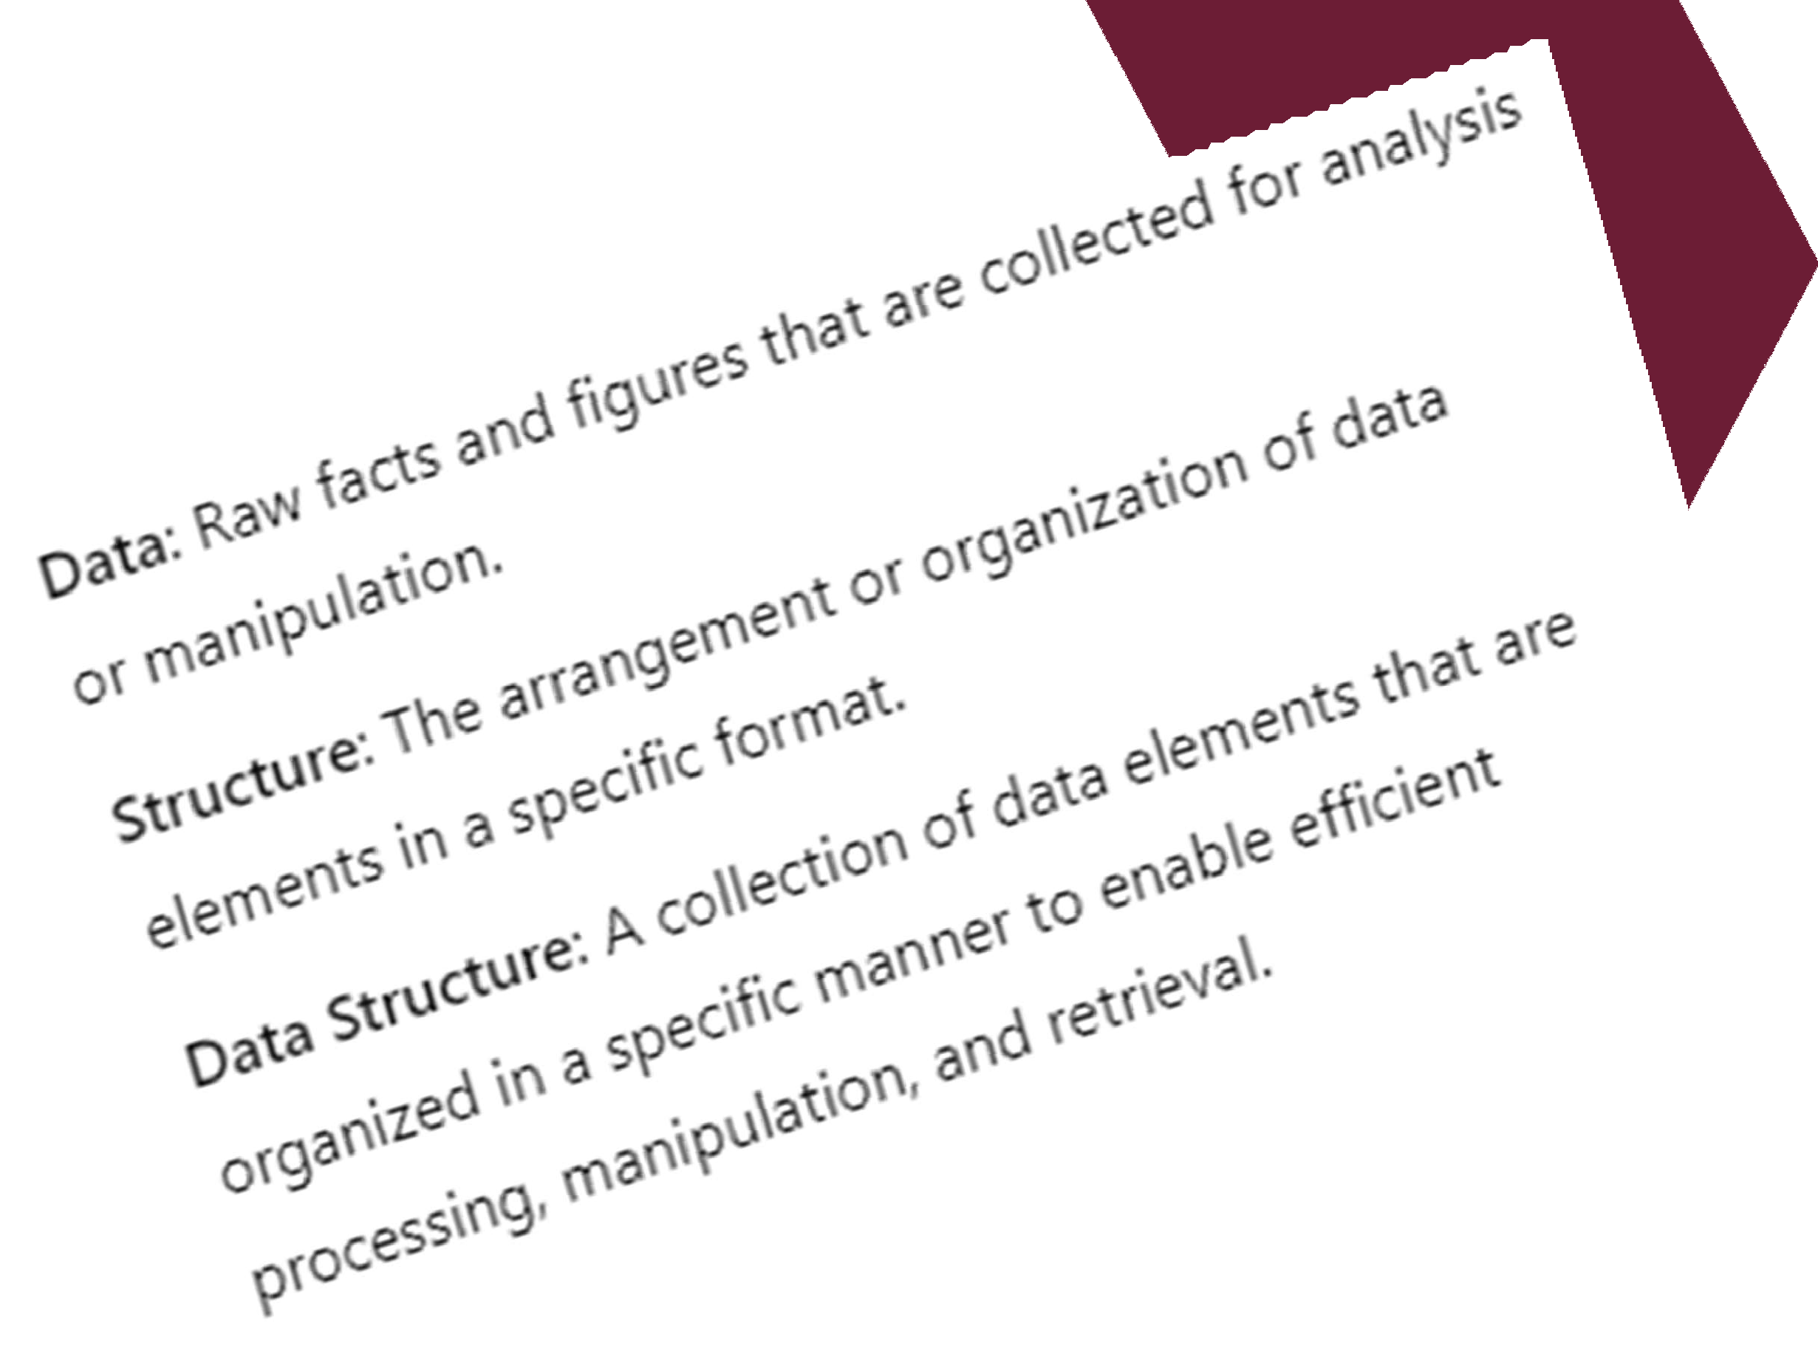



CONCLUSION
Data structures are the foundation for organizing and managing data in a way that allows efficient processing and access.
Choosing the right data structure can greatly improve the performance of an application, allowing it to handle larger datasets and perform more efficiently.
Mastering data structures is essential for building high- performance applications, solving complex computational problems, and advancing in fields like software development, AI, and data science.
SPACEUTMKL

Slide 32






EXERCISE
UNIVERSITI TEKNOLOGI MALAYSIA
SPACEUTMKL

Slide 33
Exercise 1: Discussion
Hints for Data Structure Design: 1.Classes or Objects:
•Create a Book class with attributes like title, author, genre, ISBN, and is_available.
•Create a Borrower class to store details about people borrowing books.
2.Storage:
•Use a dictionary to store books with the ISBN as the key for quick lookups.
•Use lists for storing books by genres, authors, or titles if needed.
3.Operations:
•Add methods for adding, removing, and searching books.
•Maintain a checkout log to track who borrowed which book and the due date.
Design a Library Management System Problem Statement:
Design a data structure to manage books in a library. The system should support the following operations:
Add a book with details such as title, author, genre, and ISBN.
Remove a book by its ISBN.
Search for books by title, author, or genre.
Check out a book to a borrower and track due dates.
Return a book and update its availability.
www.utm.my

Slide 34

Exercise 1: Discussion (continue)
Follow-up Questions:
What if multiple copies of the same book exist? How would you handle that?
How would you scale this system for millions of books?
How can you optimize searches for faster lookups?
www.utm.my

